Slide 2
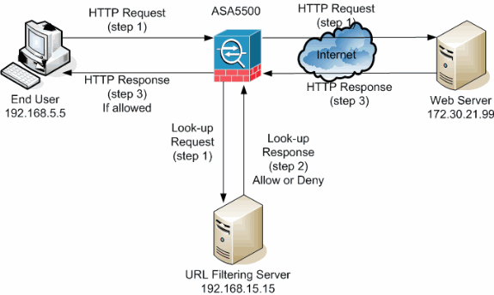
Basic Web Architecture
The Web is a two-tiered architecture
A web browser displays information content
A Web server transfers information to the client.

Slide 3
HTML Elements
<tagname>content</tagname>
<p>My first HTML paragraph.</p>
HTML elements can be nested (elements can contain elements).
All HTML documents consist of nested HTML elements

Slide 4
HTML Attributes
HTML elements can have attributes
Attributes provide additional information about an element
Attributes are always specified in the start tag
Attributes come in name/value pairs like: name="value"

Slide 5
Html form
HTML forms are used to collect user input
HTML forms contain form elements
<form> First name:<br> <input type="text" name="firstname"><br> Last name:<br> <input type="text" name="lastname"> </form>

Slide 6
Html form
HTML forms are used to collect user input
HTML forms contain form elements
<form> First name:<br> <input type="text" name="firstname"><br> Last name:<br> <input type="text" name="lastname"> </form>

Slide 7
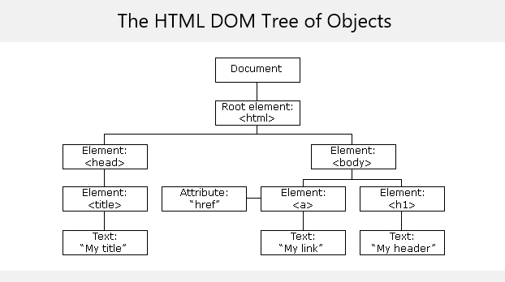
Html dom

Slide 8
JavaScript-Data Types
To be able to work with variables, the program must know about data types.
In JavaScript variables are defined by ‘var’
Data types are interpreted by JavaScript.
Example: var x = 5 + “FAST";

Slide 9
JavaScript - Objects
JavaScript objects are written with curly braces.
Example:
var person = {firstName:“Muhammad", lastName:”Ali", age:50, eyeColor:"black"};
document.getElementById("demo").innerHTML =
person.firstName + " is " + person.age + " years old.";

Slide 10
Regular Expression Patterns
Example:
Expression Description
[abc] Find any of the characters between the brackets
[0-9] Find any of the digits between the brackets
(x|y) Find any of the alternatives separated with |

Slide 11
MVC
Model:
Model holds the real business logic and sate. It is the only part which talks to the DB.
View:
Responsible for the presentation. It gets the state of the model from the controller. It also gets user input that goes back to the controller.
Controler:
Takes the user input from the request and figuers out what it means for the model. Tells the model to update itself and makes the new model state available for the view (JSP)

Slide 12
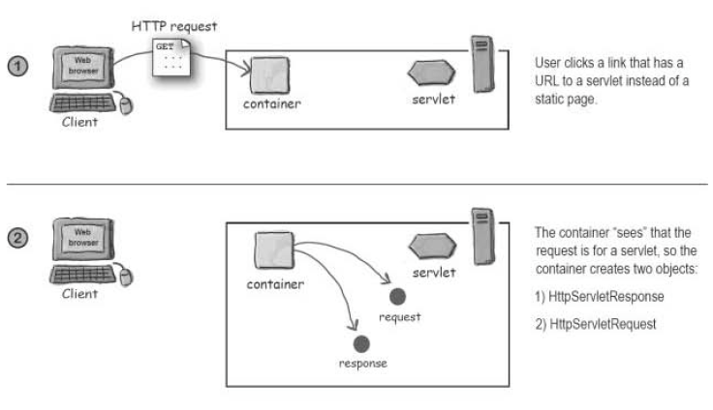
How a Container Handles a Request.

Slide 13
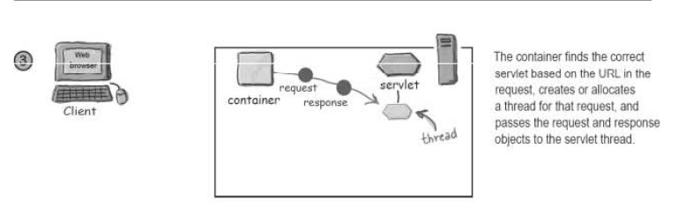
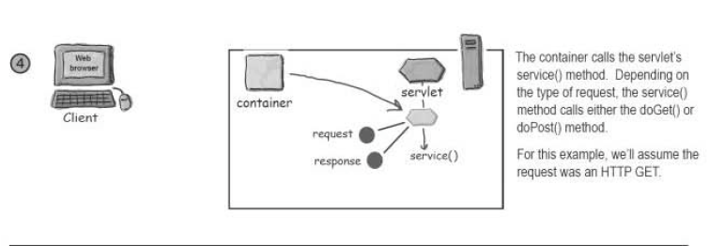

Slide 14
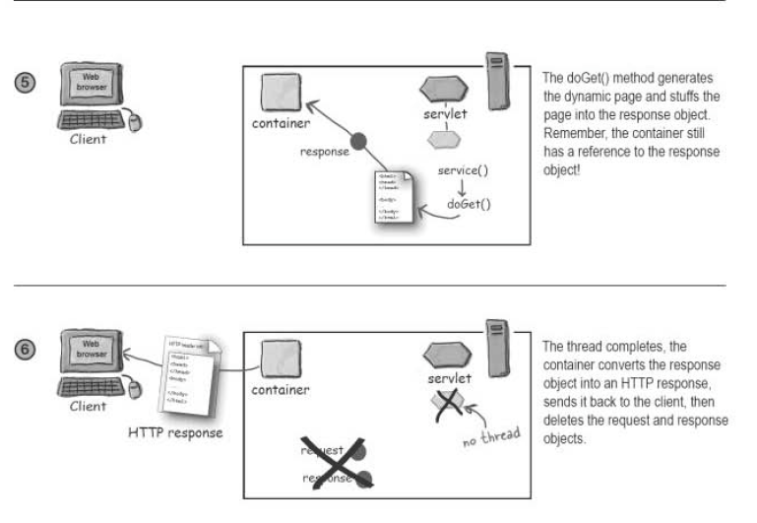

Slide 15
Choosing a Technology
Languages and Platforms
Python
PHP
JavaScript
Java
.Net
JavaScript Frameworks
Angular.js
React
Polymer
Ember.js
Vue.js
Frontend
Bootstrap
Foundation
MDL
SASS
Backend
PHP: Symfony, Zend, Laravel
Java: Play and Spark
Node.js: Express, Hapi and Sails.js
AWS Lambda
CMS
WordPress
Drupal 8
Adobe AEM
Salesforce.com (Site.com)

